Slide 1
Understanding Russia – History, Society, Politics
Viacheslav Shironin
http://shironin.com/Finec22
vm@shironin.ru

Slide 2
Introduction
Russia-Ukrainian conflict: a case study

Slide 3
Contents
I. Some geographical and historical facts
II. Social and political cultures in Russia and Ukraine
III. The political dynamics in Russia and Ukraine after 1991
IV. NATO expansion and the security issue
V. The euromaidan, annexation of Crimea and Donbass
VI. Changing World order

Slide 4
I. Some geographical and historical facts

Slide 5
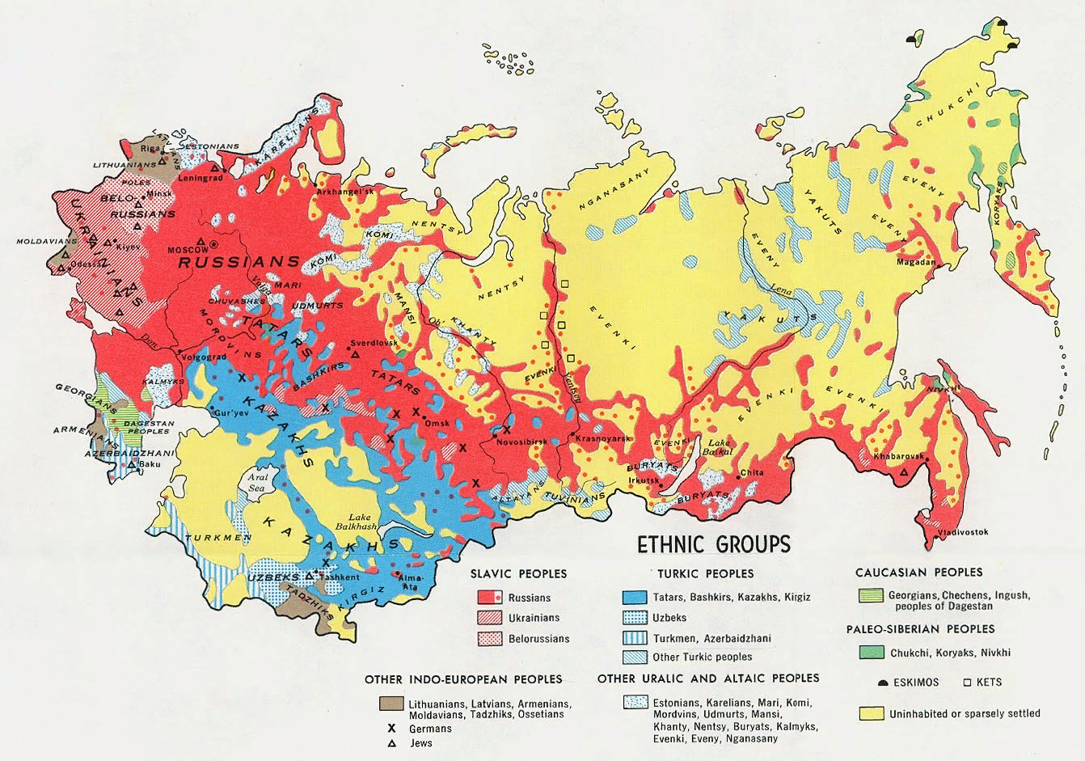

Slide 6
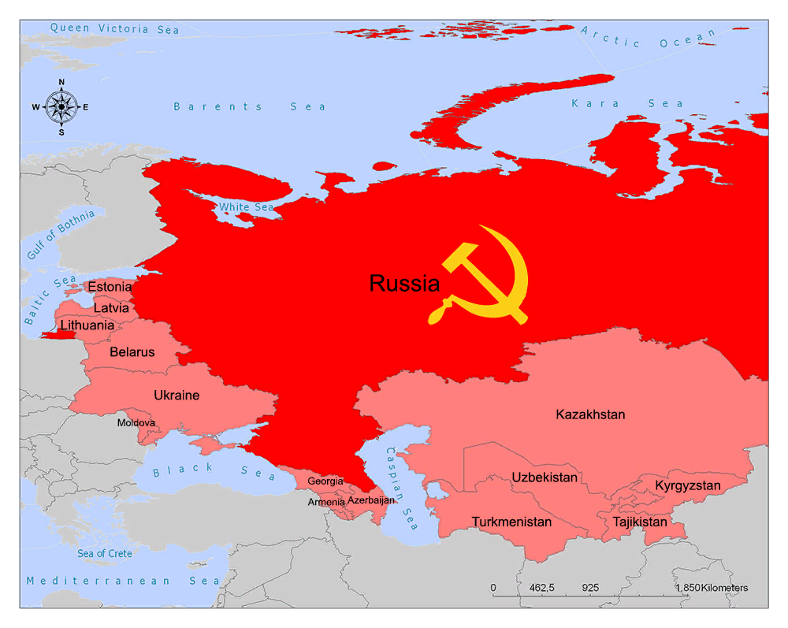
Russia and Ukraine as parts of the USSR

Slide 7
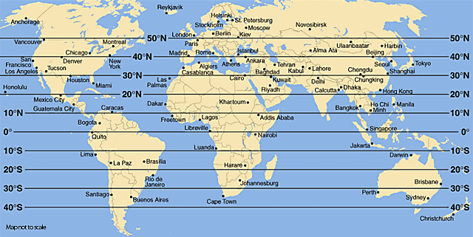
Russia is a northern country

Slide 8
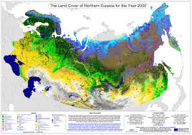
Ecosystems of Eurasia

Slide 9
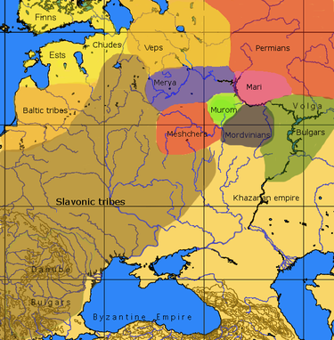
Tribes in Eastern Europe, VIII-X centuries

Slide 10
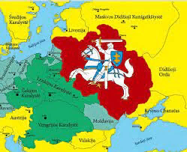
Polish-Lithuanian Commonwealth

Slide 11
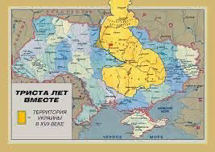
Ukraine as part of Moscow Tsardom in XVII c.

Slide 12
Russian and Ukrainian language
A Russian speaker can understand only the general idea expressed in Ukrainian (and vice versa)
That is, they are different languages, not dialects of the same language
They use nearly the same alphabet
Their grammar is somewhat different

Slide 13
Russian and Ukrainian language (continued)
Practically, 100 percent of Ukrainians speak Russian and it is the mother tang of about half
It may be argued that Russian language has been more developed, especially as regards professional termonologies
Russian words can easily be (and often are) ‘ukrainized’ and used in Ukrainian speech

Slide 14
Nearly every Russian family has relatives of Ukrainian origin

Slide 15
II. Social and political cultures in Russia and Ukraine

Slide 16
Russia: obshchina, kolkhoz, factory
Tradition of collective work
Vague idea of property
Respect for the authority

Slide 17
Ukraine: private farming
Individual work on one’s private plot
Independence
Cossack tradition of military democracy

Slide 18
Present-day Ukrainian political cultures
‘Orange’: pro-Western, pro-EU, support joining NATO, believe in the liberal democracy, anti-Russian
‘Blue’: pro-Russia, like the old Soviet culture, Eurosceptic, often anti-American, not very liberal

Slide 19
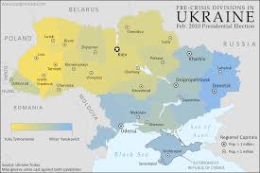
Ukrainian politics prior to 2014

Slide 20
Ukraine’s historical map: territories added – when and by whom

Slide 21
Historical narratives
‘Orange’: for the Ukrainians, the World War II was about replacement of one nasty regime by another one. The Ukrainian nationalists who fought on the German side were heroes
‘Blue’: it was the Great Patriotic War. People like Bandera were fascists.

Slide 22
‘Political Ukrainism’
Ethnical nationalism
Unitary state and rejection of federalism
Ukrainian as the only official language (while often native Russian speaking)

Slide 23
What is rare in both Russia and Ukraine is true understanding of how the modern Western culture practically operates: legal procedures, contract relations, democratic mechanisms, ethics, etc.

Slide 24
III. The political dynamics in Russia and Ukraine after 1991
Russia:
1993: presidential republic
1990ies: war in Chechnia
Creating Putin majority
‘Equidistancing of oligarchs’: eliminating ‘private capture’ of media and legislature
Building the ‘vertical of power’
Developing a ‘sovereign democracy’
Building a version of ‘petrostate’
Reconsidering foreign policy

Slide 25
Political dynamics (continued)
Ukraine:
‘Blue’ voting and ‘orange’ activists
The phenomenon of maidan
Balancing between Russia and the West
Ethno-nationalisim as the leading narrative

Slide 26
IV. NATO expansion and the security issue

Slide 27
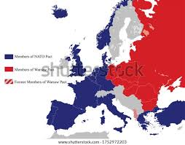
NATO expansion
NATO and Warsaw Pact
NATO today

Slide 28
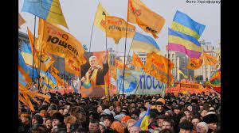
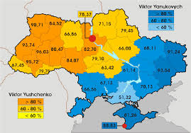
2004: the Ukrainian Orange Revolution

Slide 29
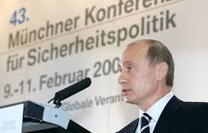
10.02.2007 Munich speech of Vladimir Putin

Slide 30
IV. The euromaidan, annexation of Crimea and rebellion in Donbass

Slide 31
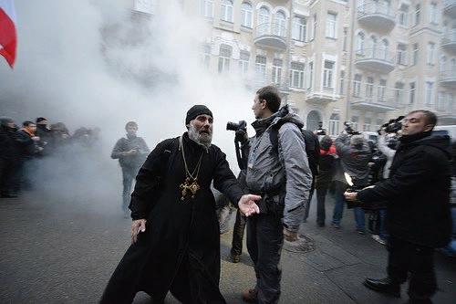
Euromaidan

Slide 32
Euromaidan story as per an Indian source https://youtu.be/h2P9AmGcMdM
‘They spoke so much about the European Union association agreement and created a massive hype among the Ukrainian public; the Ukrainian public saw this as a civilizational choice: they wanted to get away from the old Soviet-Russian culture.
On 21st November 2013 the government went back on its promise and suspended the signing of European Union / Ukraine association agreement.

Slide 33
Euromaidan story (continued)
That created a civil unrest in Ukraine; initially it was a protest that turned into riots, then civil disobedience and later into a movement and this was also called the euromaidan
The agreement on settlement of political crisis in Ukraine was signed on 21 February 2014 by Yanukovych under the mediation of European Union and the Russian Federation.
Shortly after the agreement was signed Yanukovich and other high government officials fled the country; afterwards the parliament removed Yanukovych from office.
Soon there was a fresh protest in Crimea and also in the regions of Eastern Ukraine where majority public were Russian speaking.’

Slide 34
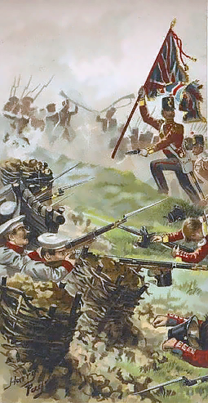
Russian attitudes towards Crimea
Russo-British skirmish during the Crimean war
Crimean Khanate was a key source of trouble for the Moscow Tsardom and the Russian Empire during XVI-XVIII centuries. ‘The slave trade was the backbone of the economy of the Crimean Khanate.’ (WP)
It was annexed by Catherine the Great in 1783

Slide 35
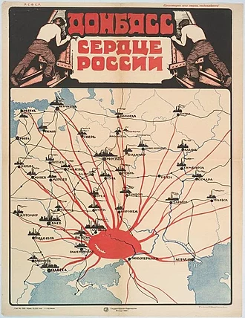
Donbas
Soviet Russian propaganda poster from 1921 that says "Donbas is the heart of Russia"

Slide 36
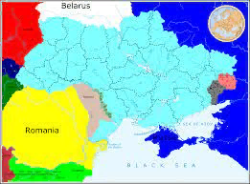
Donetsk, Luhansk and Crimea

Slide 37
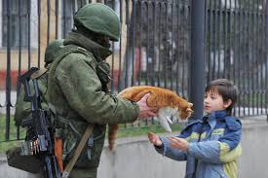
The ‘polite men’ in Crimea

Slide 38
The Minsk agreements
On 5th September 2014 France, Germany, Russia and Ukraine came up with a ceasefire agreement through the Minsk agreement; so basically the aim of this agreement was to end the war in the Donbass region of Ukraine; Minsk is the capital of Belarus.
If you see from Russia's perspective, Russia wants autonomy of Donbass, Russia wants this region to govern itself and control its own affairs because Russia is confident that here the people are Russian-speaking and they are pro-Russians so it will be easy for Russia to exercise military and political influence.
Ukraine had a demand, it first wanted a complete ceasefire and withdrawal of all Russian troops and weapons; only then the elections would be held; basically Ukraine wanted to regain control.

Slide 39
VI. The changing World order
Ray Dalio
https://www.youtube.com/watch?v=xguam0TKMw8

Slide 40
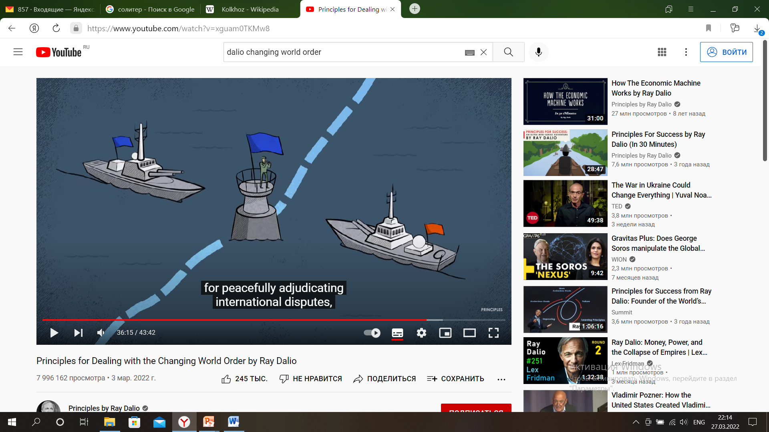
‘There is no viable system for peaceful adjudicating international disputes…’

Slide 41
